Slide 1
Strings &
Sample programs

Slide 2
Strings
Strings are stored in memory as array of characters. Each character in English alphabet has an 8-bit unique numeric representation called ASCII.
When we read a string from the user, the user will give an enter key press at the end of the string.
When we read that using the read system call, the enter press will be replaced with a new line character with ASCII code 10 .
Thus we can detect the end of the string.

Slide 3
1. Declaring/ Initializing a string
section .bss
string: resb 50

Slide 4
Reading a string
Pseudo Code:
i=0
while(char!=’\n’)
read(char)
*(arr+i)=char
i++
endwhile

Slide 5
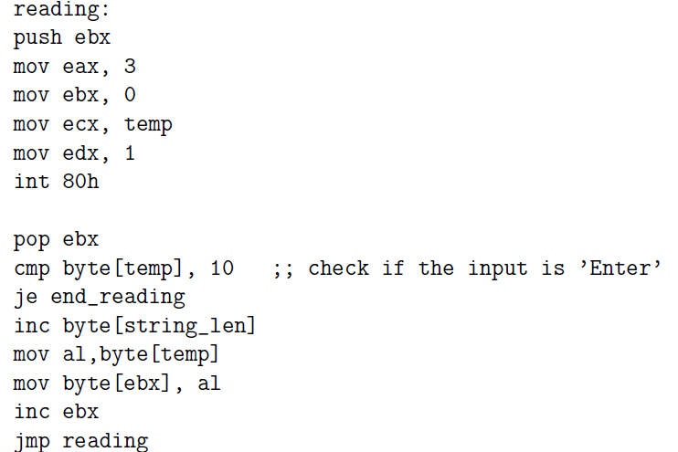

Slide 6
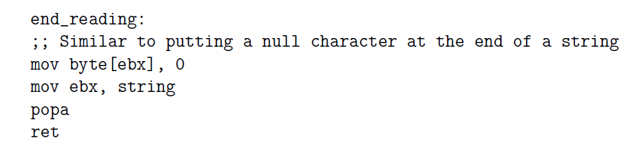

Slide 7
Printing a string
Pseudo Code:
while(*(arr+i)!=’\n’)
print(*(arr+i))
i++
endwhile

Slide 8
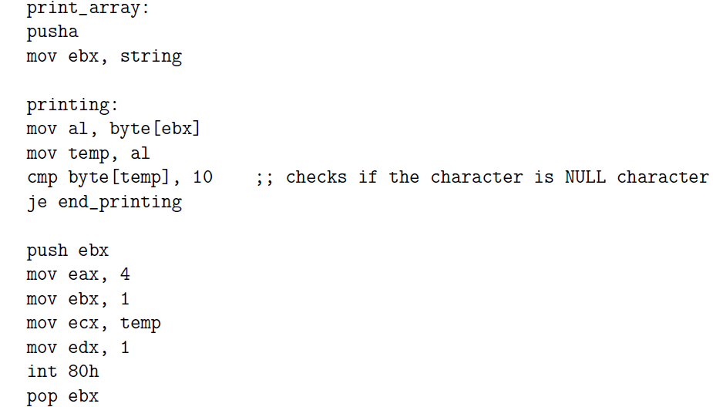
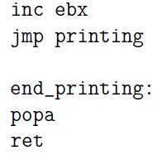

Slide 9
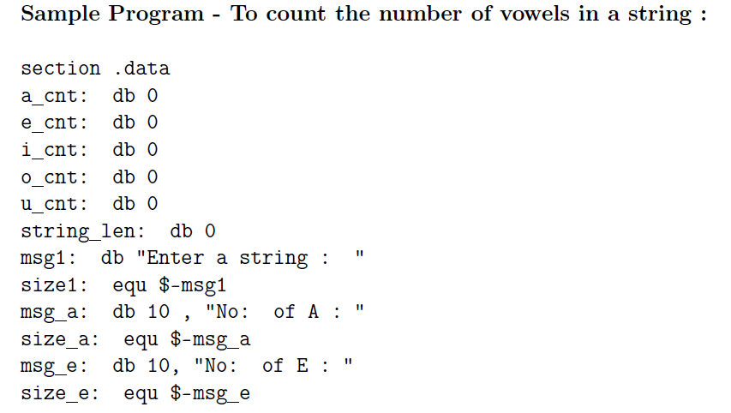

Slide 10
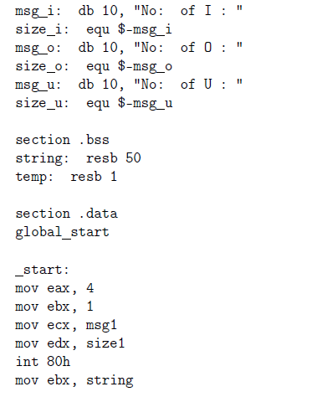

Slide 11
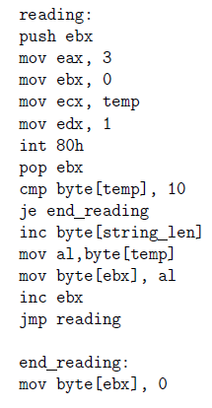

Slide 12
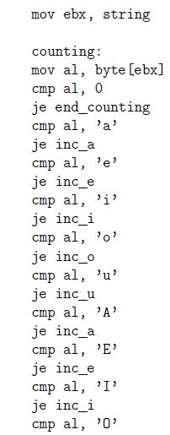

Slide 13
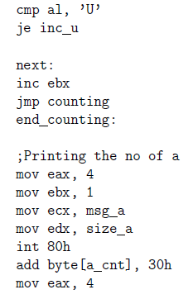

Slide 14
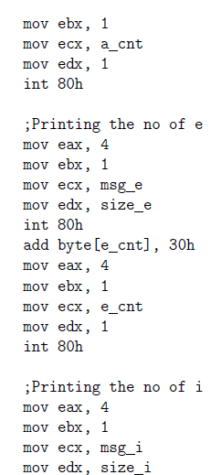

Slide 15
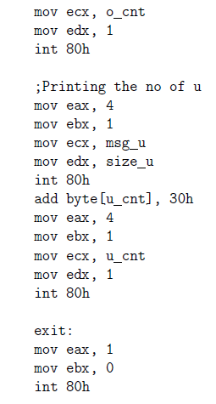

Slide 16
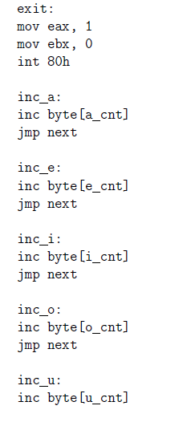
jmp next

